Slide 1
Creating Command Line Tools with C# & .NET Core SDK
Thomas Monfre, ‘21

Slide 3
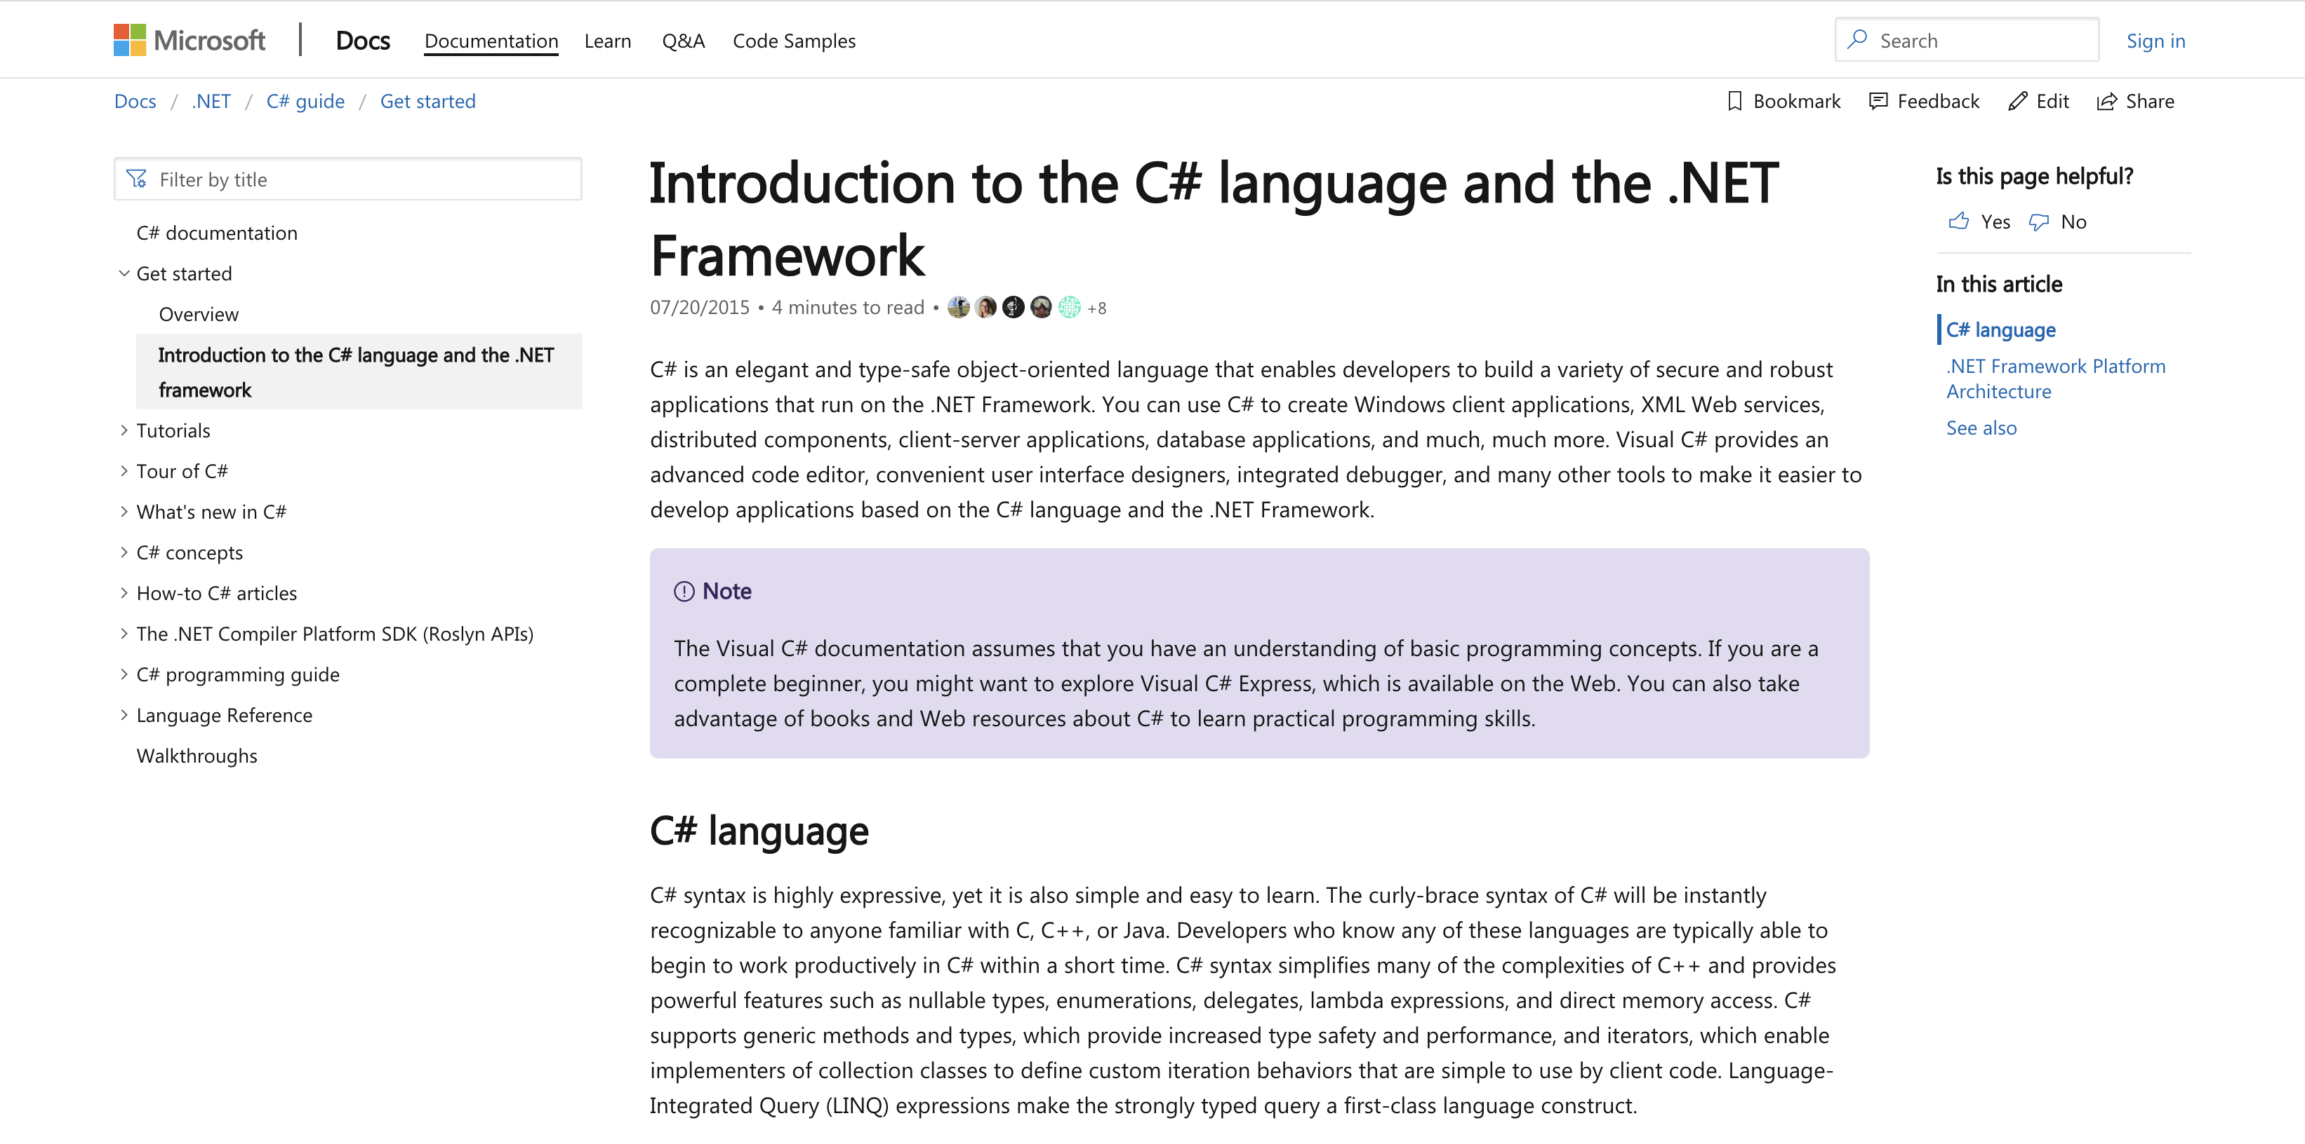
What’s C#/.NET?

Slide 4
TLDR;
C# ➔ Language
.NET ➔ Framework/Run-Time Environment
.NET Core SDK ➔ Our framework SDK of choice

Slide 5
Today’s Workshop
Kronos UI sucks
I hate logging Kronos time, but I like the $$
So I log time on Kronos as little as I can
But that means I forget when I worked on stuff
I try to keep track with Notes
But lists are lame and annoying
Let’s write some basic software to keep track for us!

Slide 6

As we go, follow this repository: https://github.com/dali-lab/c-sharp.NET-CLI-workshop

Slide 7
Setup

Slide 8
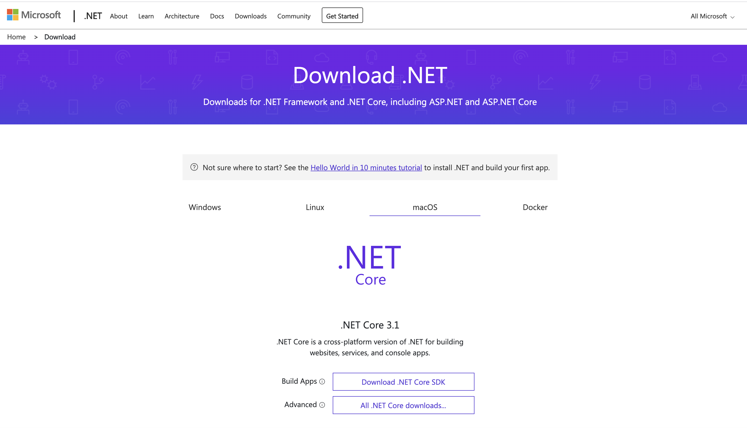
Download .NET Core 3.1 https://dotnet.microsoft.com/download

Slide 9
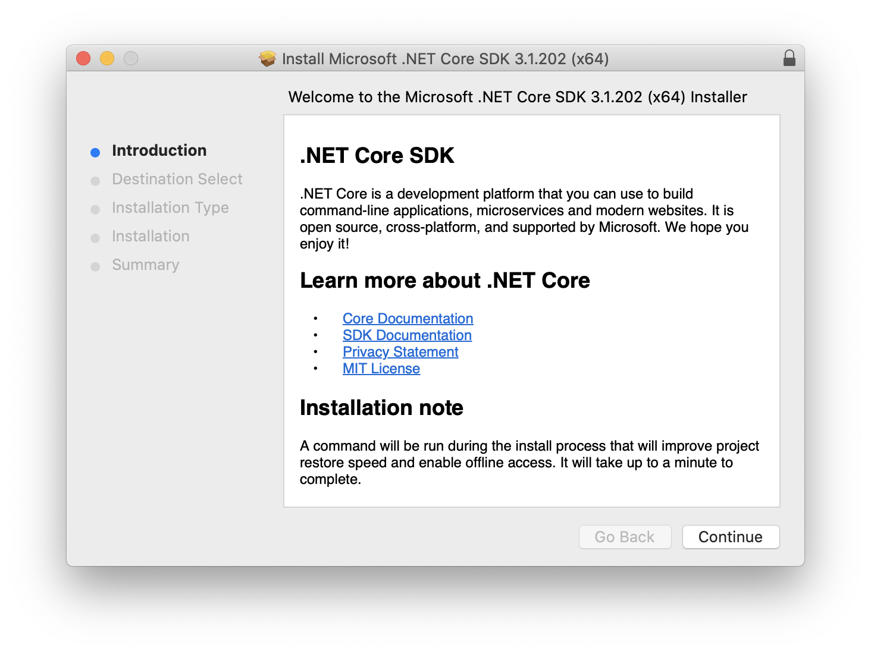

Slide 10
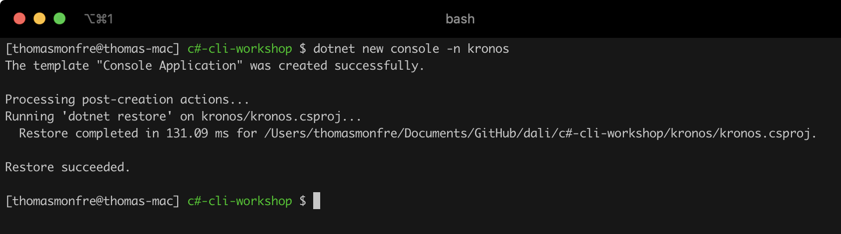
Step One: Create CLI Tool

Slide 11
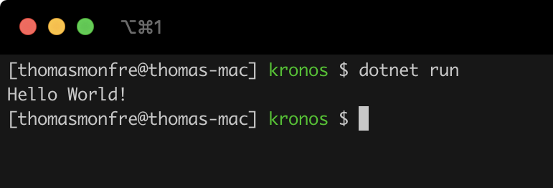
Step Two: Quick Test

Slide 12
Step Three: Set Up Build Config
Things to know:
All the magic happens in your .csproj file
You can set up your entire build config here
More complex apps (on Windows) will use nuke for building
Can publish to NuGet with config setup here (like npm)
Can publish internally to private build environment like Artifactory

Slide 13
Step Three: Set Up Build Config
<PackAsTool>true</PackAsTool>
<ToolCommandName>kronos</ToolCommandName>
<PackageOutputPath>./nupkg</PackageOutputPath>

Slide 14
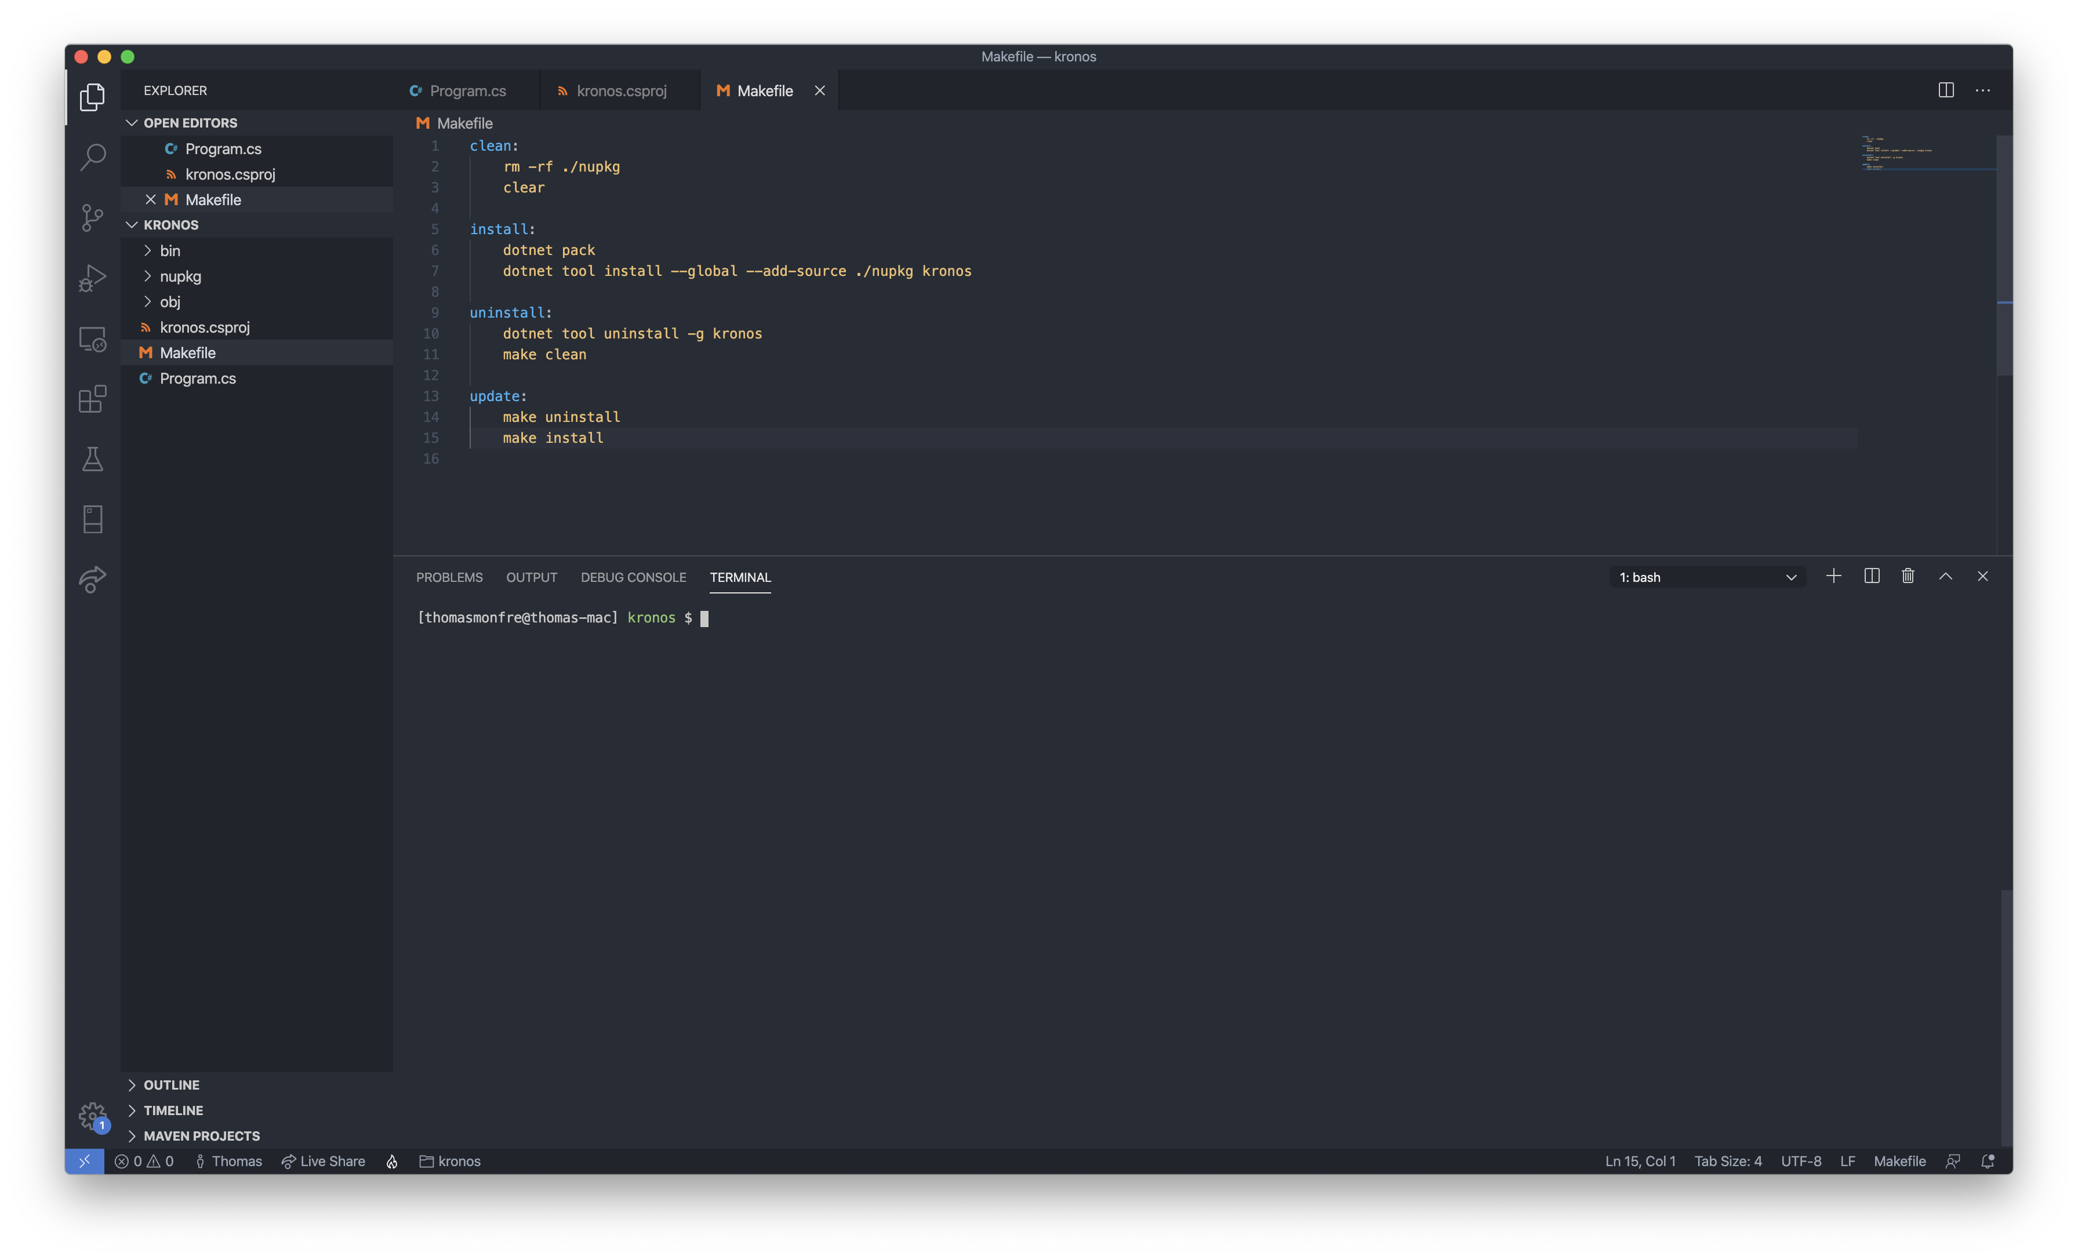
Step Four: Makefile

Slide 15
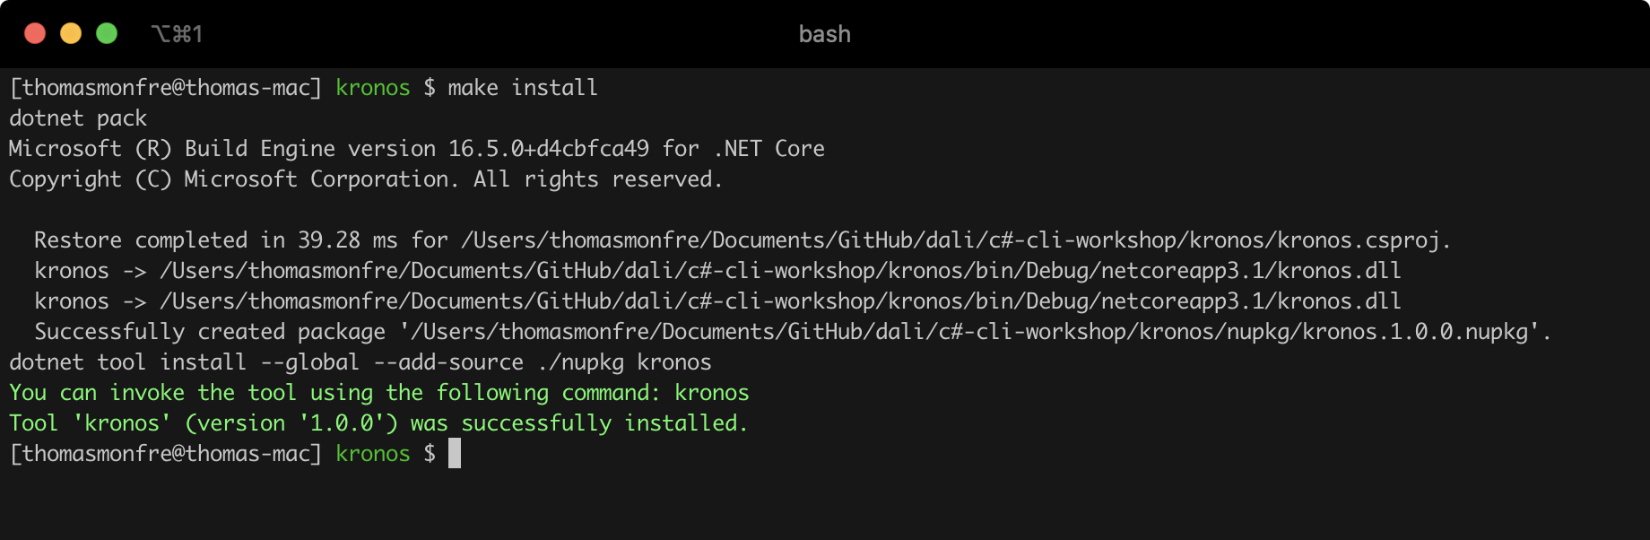
Step Five: Install

Slide 16

Step Six: Test

Slide 17
Define Our App

Slide 18
Desired functionality
Start work session
Stop work session
Log previous work session
Clean up/delete old work sessions
Track repositories to auto-detect changes

Slide 19
Commands
kronos start
kronos stop
kronos log --start, --stop, [-m/--message]
kronos report [--all]
kronos clean [-f/--force]
kronos track [filepath]

Slide 20
Build App

Slide 21
C# Basics
Namespace
Class names
Capitalization (PascalCase: public/static, camelCase: private/instance)
All the things you love about Java + all the things you love about C + none of the things you hate about C + some tricks from JavaScript too
What’s not to love about that 👆

Slide 22
Root File: Program.cs
Think of this like index.js or App.js
Goal: easily parse user command line arguments
Pass on functionality to various in-app handlers based on user selection

Slide 23
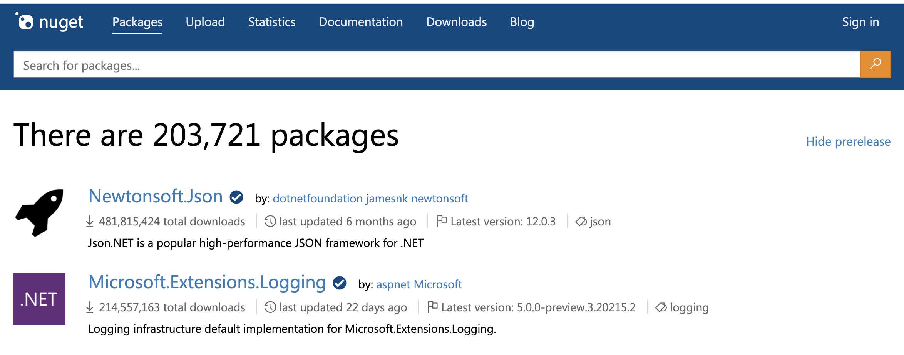
Nuget https://www.nuget.org/packages
Basically npm but for C#/.NET

Slide 24
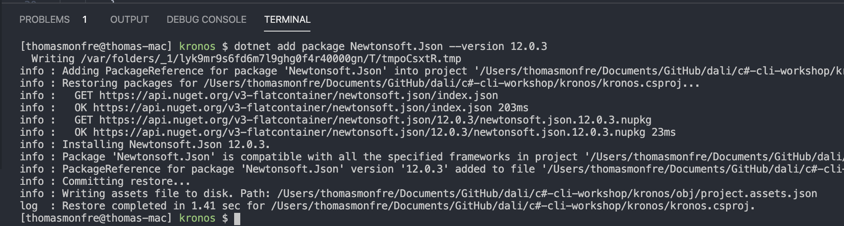
JSON Handling https://www.nuget.org/packages/Newtonsoft.Json/
dotnet add package Newtonsoft.Json --version 12.0.3

Slide 25
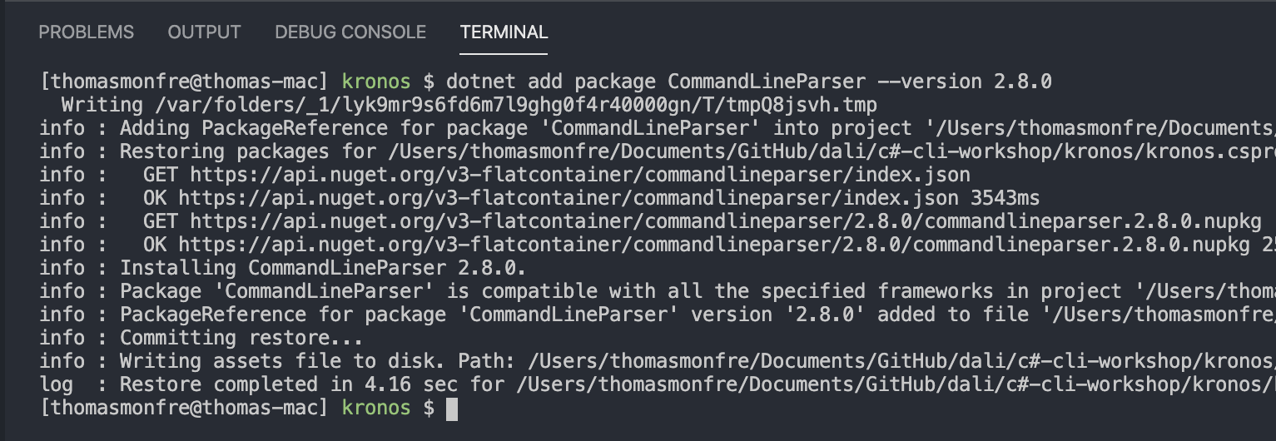
Solution: CommandLineParser https://www.nuget.org/packages/CommandLineParser/
dotnet add package CommandLineParser --version 2.8.0

Slide 26
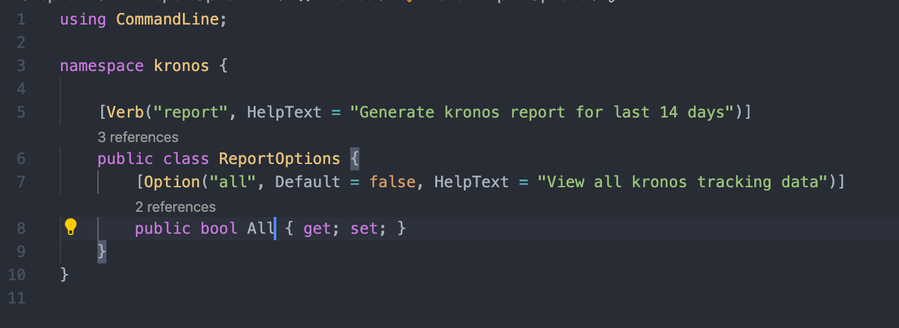
Verb Options

Slide 27
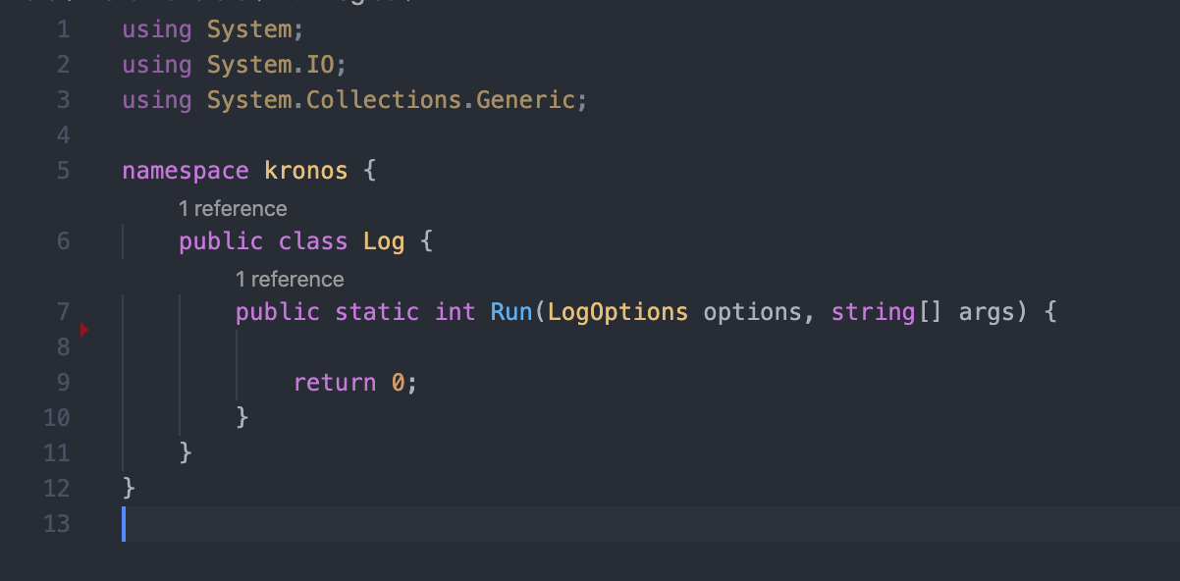
Verb Handlers

Slide 28
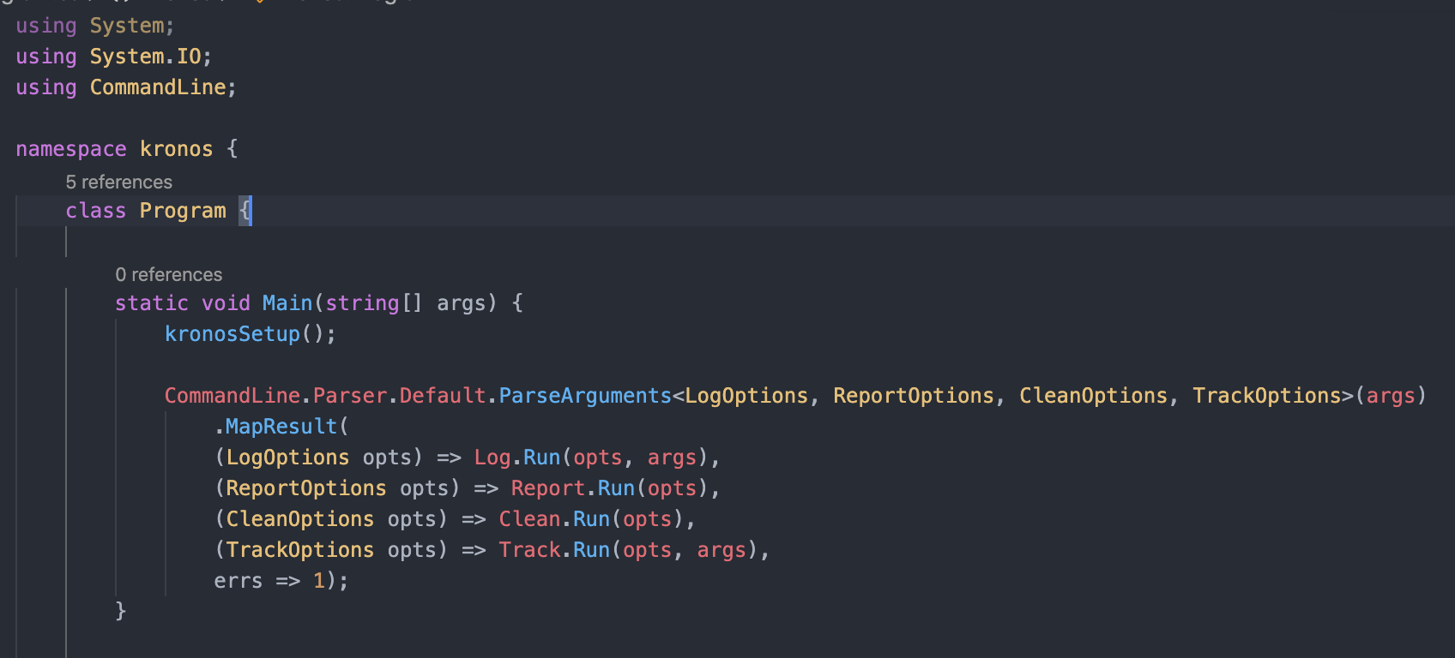
Putting it All Together

